Slide 1
Week 2 – B Tree
Remco van Alen, 507276
Bas van Summeren, 479334

Slide 2
De opdracht
Make a demo of one of the standard search trees. In all cases, deletion from the structure is optional. It makes for an even harder excercise. Choose from:
AVL (technically rather difficult)
B-tree (easy: 2-3-tree, middling: 2-4-tree, hard: B-tree proper)
Red-Black Tree (not covered which makes it harder, but these trees are somewhat easier to program than AVL -trees)

Slide 3
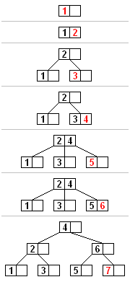
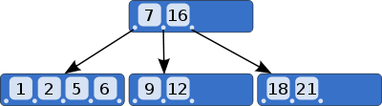
De uitvoering van een B-Tree
De eerste stap is het creëren van een generieke Java KeyValuePair
Gestart met een tree met subtrees
Code om door de kinderen te lopen

Slide 4
Het resultaat
public class KeyValuePair<K extends Comparable, V> implements Comparable<Comparable>

Slide 5
Het resultaat
public V put(K key, V value) { BTree<K, V> next = this; BTree<K, V> tree; do { tree = next; if (tree.hasKeyInNodes(key)) { return tree.getPair(key).setValue(value); } else if (tree.nodes.size() < nodeSize) { if (tree.nodes.size() > 0) { for (int i = 0; i < tree.nodes.size(); i++) { //Add to the nodes list at a location; //Shift the subtrees if (tree.nodes.get(i).compareTo(key) > 0) { tree.nodes.add(i, new KeyValuePair<K, V>(key, value)); tree.subtrees.add(i, new BTree<K, V>(nodeSize)); return null; } else if (i == tree.nodes.size() - 1) { tree.nodes.add(new KeyValuePair<K, V>(key, value)); tree.subtrees.add(new BTree<K, V>(nodeSize)); return null; } } } else { tree.nodes.add(new KeyValuePair<K, V>(key, value)); tree.subtrees.add(new BTree<K, V>(nodeSize)); tree.subtrees.add(new BTree<K, V>(nodeSize)); return null; } } next = tree.getNextTree(key); } while (next != null && ! tree.equals(next)); return null; }

Slide 6
Het resultaat
protected BTree<K, V> getNextTree(K key) { for (int i = 0; i < nodes.size(); i++) { int comparison = nodes.get(i).compareTo(key); if (comparison == 0) { return this; } else if (comparison > 0) { return subtrees.get(i); } else if (comparison < 0 && i == (nodeSize - 1)) { return subtrees.get(i + 1); } } return null; } protected KeyValuePair<K, V> getPair(K key) { BTree<K, V> tree = this; while (! tree.hasKeyInNodes(key) && tree != null) { tree = tree.getNextTree(key); } if (tree != null) { for (KeyValuePair<K, V> pair : tree.nodes) { if (pair.compareTo(key) == 0) { return pair; } } } return null; }

Slide 7
Het resultaat
public V get(Object key) { try { return getPair((K) key).getValue(); } catch (ClassCastException e) { return null; } }

Slide 8
Problemen van implemenatie
Doordat alle subtrees de zelfde klassen zijn is het lastig de root te vervangen.
Hierdoor kunnen nodes niet naar boven getrokken worden
Geen balanceer slagen

